Slide 1
Introduction to New Innovations
Evaluations Management System
Kendrick Davis kendrick.davis@ucr.edu
Ariel arield@medsch.ucr.edu
Notes:
Evaluation system – clinically oriented, features geared more toward MS3 MS4 – case logging, duty hours. MS1 MS2 use evaluation feature.

Slide 2
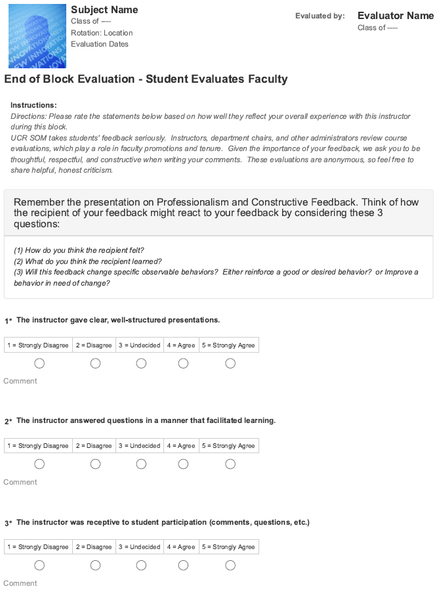
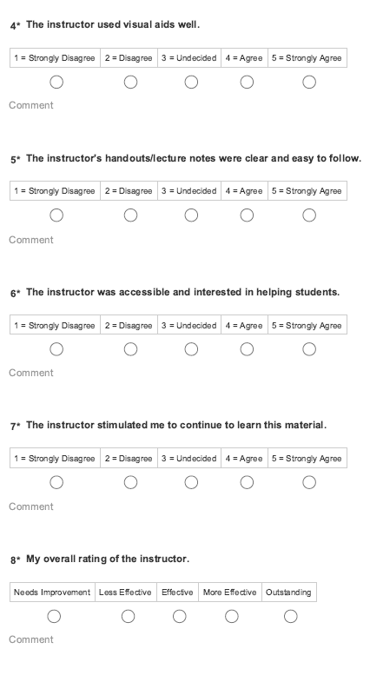
Notes:
Example of student evaluating faculty member. This one is end of block. Other evals include Clinical Skills, PBL, LACE. For faculty merit and promotion, and quality improvement.

Slide 3
Notes:
Example of CBL facilitator evaluating student. Does not count toward grade. Formative feedback.

Slide 4
https://www.new-innov.com
Notes:
New Innovation website – management system, MS1 MS2 use only evaluation module.

Slide 5
Notes:
Login button

Slide 6
Username = your netID (netID@medsch.ucr.edu) Temporary password = (all lowercase) 1st initial + last name e.g. Scotty de La-Bear “sde la-bear”
Notes:
Credentials, initial password

Slide 7
Notes:
Continue login – UME only

Slide 8
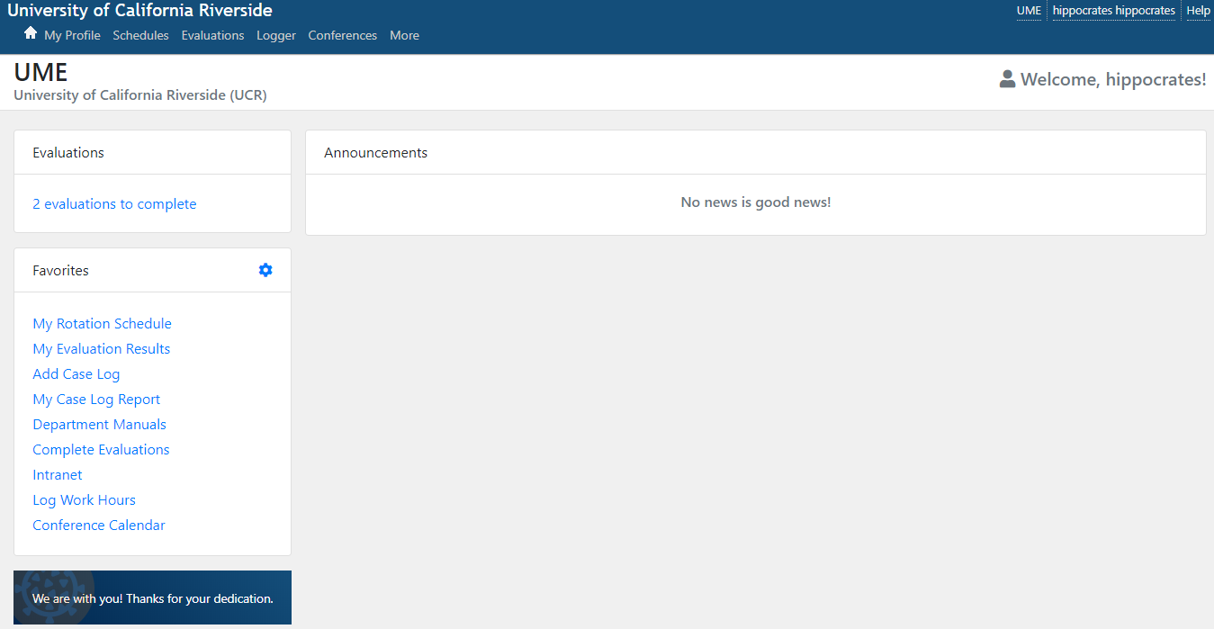
Notes:
Homepage – MS1 MS2 interest -> evals to complete and reports

Slide 9
Notes:
Evals in queue for hippo to complete – one for the Psych rotation, one for a family medicine faculty. Evaluations inadvertently/incorrectly assigned can be declined. Evals remain in queue indefinitely.

Slide 10
Notes:
Back to homescreen – looking at feedback from faculty for the student

Slide 11
Notes:
Rot/Loc – evals shown pertain to these blocks, as well timeframe. Default view – all eval reports are open. The heading of an eval report is dark grey. Click on carat of heading to minimize all reports – easier viewing.

Slide 12
Notes:
All reports minimized by clicking on carat – showing 2 eval reports. Now click on carat of desired report. Also set “Items” to 500 (to see more data on single page).

Slide 13
Notes:
CBL report remains closed. Doctoring report opened/expanded. Evaluators are anonymous – vice versa to protect students. Likert scale. Comments usually at end of report (scroll down). Or….

Slide 14
Notes:
…go to “comments” tab. Constructive comments supplement/explain scoring.

Slide 15
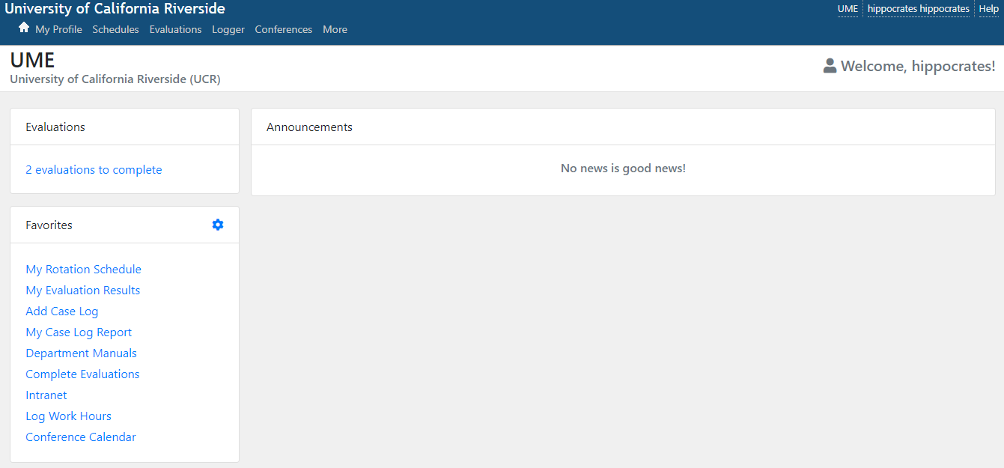
Notes:
Tabs across top – “evaluations” another way to access evals to complete as well as reports.

Slide 16
Introduction to New Innovations
Kendrick Davis kendrick.davis@ucr.edu
Ariel arield@medsch.ucr.edu
Notes:
Questions. Issues with logging in. If widespread issues, handle offline.

